Slide 1
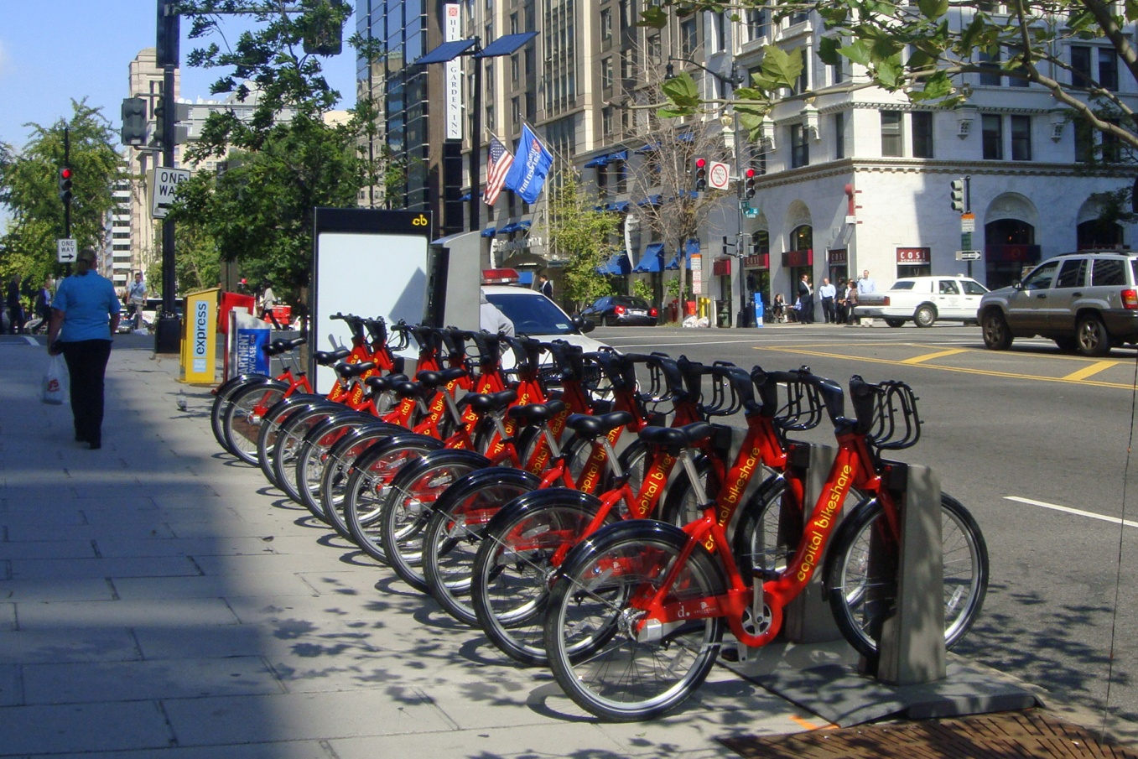
Capital Bikeshare Station and Ride Analysis
Eric Buras and Dr. Hans Engler

Slide 2
The System
Started in 2010. As of 4th quarter 2013 there are over 300 stations and ~750,000 rides/quarter
Data made freely available with start and end date, time, and station, and rider type
0h 5m 41s,6/30/2013 23:51,Florida Ave & R St NW,31503,6/30/2013 23:56,5th & K St NW,31600,W01380,Subscriber
Large Scale system concerns

Slide 3
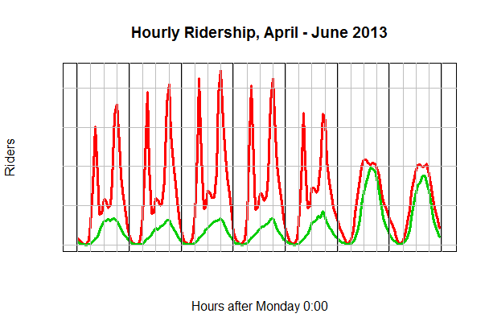
Registered vs. Casual Riders

Slide 4
Our Work
Applying Expectation-Maximization algorithm to the ride data for different models in R Statistical Software
Want to cluster ride data by a latent variable to analyze different variables (rider type, start/end station, time of day, start and end station pairs)
Identify traffic flow, similar stations, ridership patterns
Similar work done on Paris Velib system

Slide 5
Expectation Maximization
Using poisson mixture count data with the assumption that rides are independent
Iterative procedure (Expectation step followed by maximization step) that is proven to converge
E step computes the expected value of the cluster probabilities
M Step maximizes the log likelihood function parameters

Slide 6
Model 1
EM Algorithm applied to ride data with station scaling factor
Clusters according to Start Station count data

Slide 7
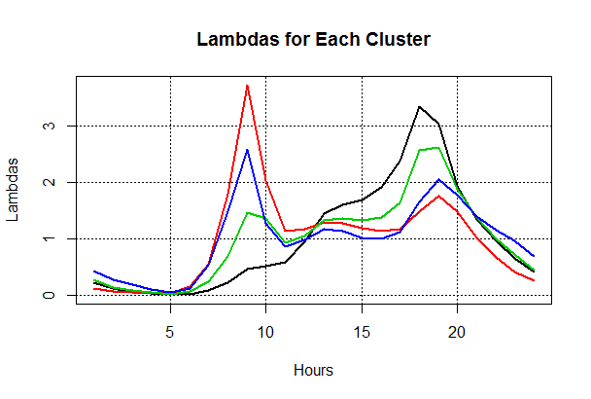

Slide 8
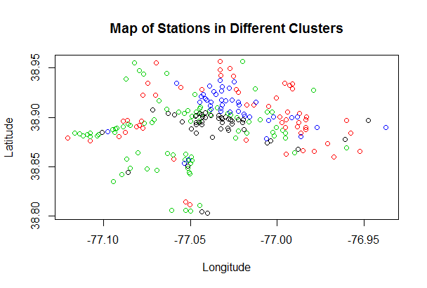

Slide 9
Algorithm Implementation
Simplify update equations to run in R quickly
Use matrix algebra and array manipulation
Different models require different iteration times (stations vs. station pairs)
Implementation very efficient even on personal laptop

Slide 10
Model 2
EM Algorithm applied to ride data with station scaling factor
Clusters according to Station-Station pair ride count
Set number of clusters but always has a group that is not assigned a cluster (cluster probability is not a super majority)
Very little or no rides between these stations

Slide 11
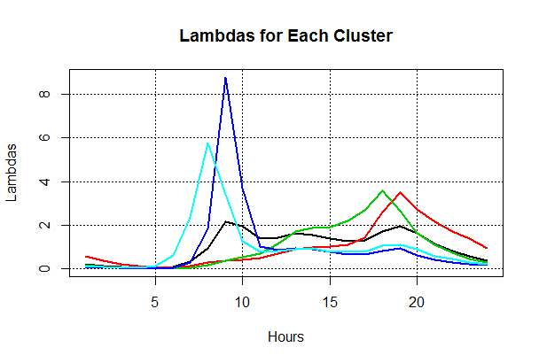

Slide 12
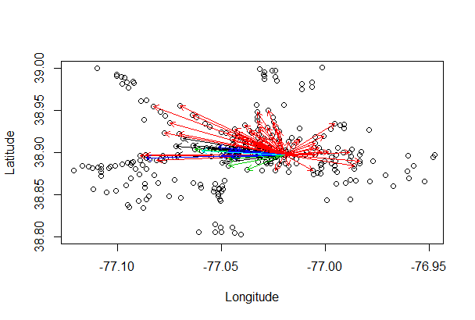
5th and F (Gallery Place) Start Station

Slide 13
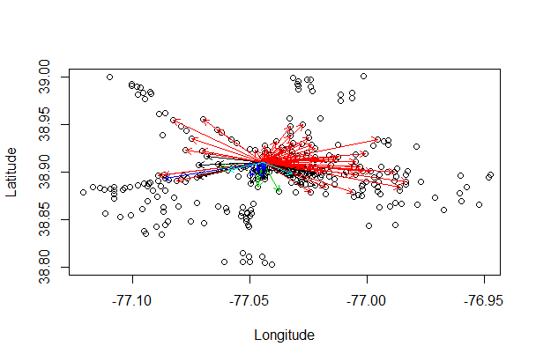
Dupont Circle Start Station

Slide 14
Variability of Results/Conclusions

